Slide 1
STL Files

Slide 2
Understanding STL files
The STL file format uses a series of linked triangles to recreate the surface geometry of a solid model. When you increase the resolution, more triangles will be used, approximating the surfaces of the 3D model better, but also increasing the size of the STL file.
If you export in too low of a resolution, the model will have visible triangles on its surface when it is printed. Most of the times this is undesirable, but it can be exploited to create "low-poly" models with a digital look.
Increasing the resolution above a certain point is also not recommended, as it brings no additional benefit: very fine details cannot be 3D printed, so the size of the file will be unnecessarily increased, making it more difficult to handle and process.

Slide 3
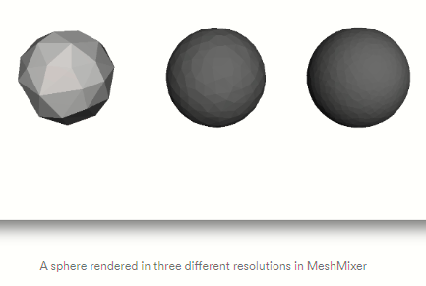
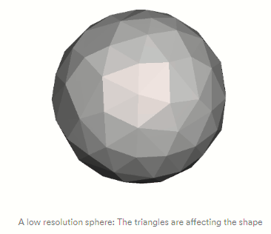
Understanding STL files

Slide 4
Choose the right exporting parameters
You can change the resolution of your STL files by altering the tolerance in your CAD software. When unsure, selecting the "high" preset is the safest option for generating an STL file that is suitable for 3D printing.
Each CAD package has a different way of specifying the STL resolution, but most use two main parameters: chord height and angle.
The chord height is the maximum distance that your software will allow between the surface of the original 3D model and the surface of the STL file. Using a smaller chord height will help represent more accurate the curvature of a surface.
The recommended value for the chord height is 1/20th of the 3D printing layer thickness and never below 0.001 mm (1 micron). This will always result in an STL file with ideal accuracy for most 3D printing applications. Exporting in a smaller tolerance will not have any effect in the quality of your print, as most common 3D printers are not able to reproduce such a high level of detail.
Binary or ASCII
STL files can store information in two different ways. These are Binary encoding and ASCII encoding. Binary files are smaller and easier to share while ASCII files are visually easy to read and check.
Binary format is recommended to use for 3D printing. However, ASCII format is suggested for those who want to manually inspect STL file for debugging.

Slide 5
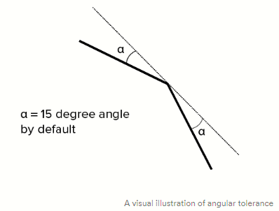
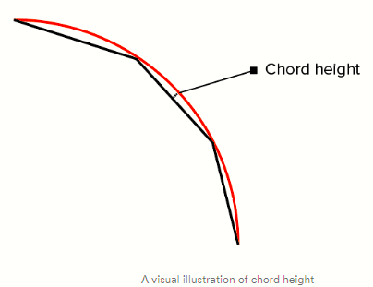
Choose the right exporting parameters
The angular tolerance limits the angle between the normals of adjacent triangles. The default setting is often 15 degrees. Some software also specify this tolerance as a value between 0 and 1. Unless a higher setting is necessary to achieve smoother surfaces, the default value of 15 degrees (or 0) is recommended.

Slide 6
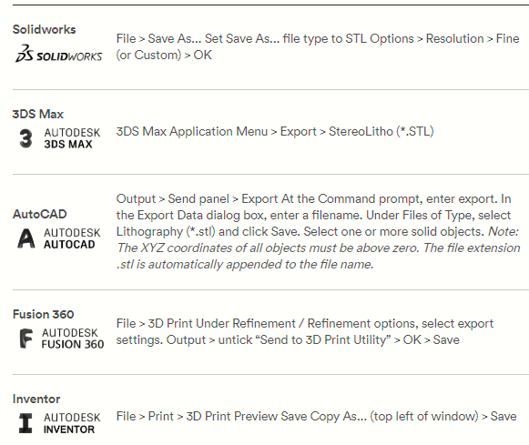
Export STL files from your CAD software
All CAD software have their own way to export STL files. Use the following table as a quick reference:

Slide 7
Special rules for STL files
There are special rules for tessellation and storing information for STL files. Below are some of them.
Vertex to vertex rule
In STL formatting, this rule states that each triangle must share 2 vertices with its neighbouring triangles. This means that a vertex of one triangle must not lie on the side of another triangle.
Orientation rule
This rule states that the orientation of the facet must be defined clearly. This orientation is specified in two ways. First, the direction of normal vector should point outwards. Moreover, the vertices should be listed in counter-clockwise order when looking at the object from the outside (or right-hand rule).
All-positive Octant rule
This rule states that all the coordinates of the triangle vertices must be positive (nonnegative and nonzero).
If the 3D part is allowed to lie anywhere in the coordinate space, then negative coordinates may occur. The problem is, when storing negative coordinates, one must use “signed floating pointing numbers”.These numbers may require an additional bit to store a sign (+/-).
Hence, it is important to ensure that all coordinates are positive. When all the coordinates are positive, it also means that more space will be saved.

Slide 8
Data interfacing for rapid prototyping
STL file format
Conceived by the 3D Systems, USA
STL interface is a file format specification for interfacing a CAD model with rapid prototyping equipment.
The STL interface was developed based on polyhedral representations widely used in graphics kernels and solid modelers.
STL file consists of an unordered list of triangular facets representing the outside skin of an object.
Precise CAD surfaces are approximated with planar and linear primitive geometric elements into a tessellated (triangular) facet boundary surface model.

Slide 9
STL file format
There are two representations
ASCII format and
The binary format
The size of the ASCII STL file is larger than that of the binary format but is human readable.
representations provide a list of triangular facets that form the STL model and, for each of the triangles, the coordinates of the three vertices of the triangle in 3D space and the associated face normal pointing outside the model surface.

Slide 10
STL file format
In STL format, the file consists of the X, Y, and Z coordinates of the three vertices of each surface triangle, with an index to describe the orientation of the surface normal.
The triangle with three vertices. The sequence of the storage of the vertices indicates the direction of the triangular face.

Slide 12
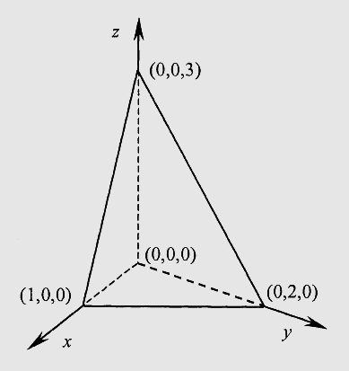
STL file system

Slide 13
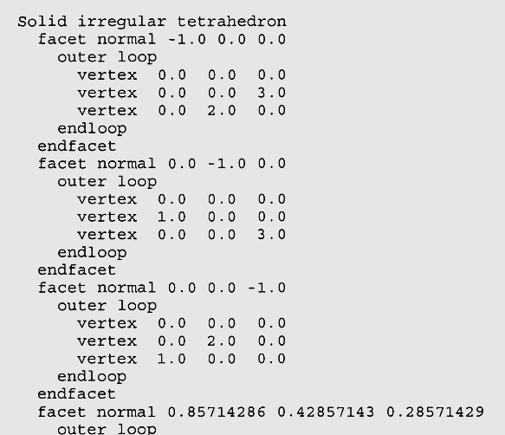

Slide 14
STL Interface Specification
There are two representations : ASCII format and the binary format
Both representations provide a list of triangular facets that form the STL model and, for each of the triangles, the coordinates of the three vertices of the triangle in 3D space and the associated face normal pointing outside the model surface.
While the ASCII format can be read and visually checked conveniently, the binary format results in a much smaller file size with a typical file size reduction of 85%.

Slide 15
STL Data Generation
All CAD systems provide an option to export it in STL file format
The conversion from a precise solid model to an approximate facet model is controlled through a tolerance specification.
For instance, Pro/Engineer allows users to specify the degree of resolution on curved surfaces by entering a quality value through its user interface

Slide 16
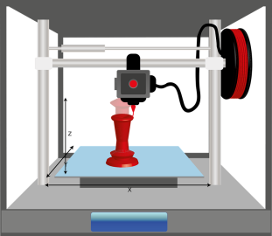
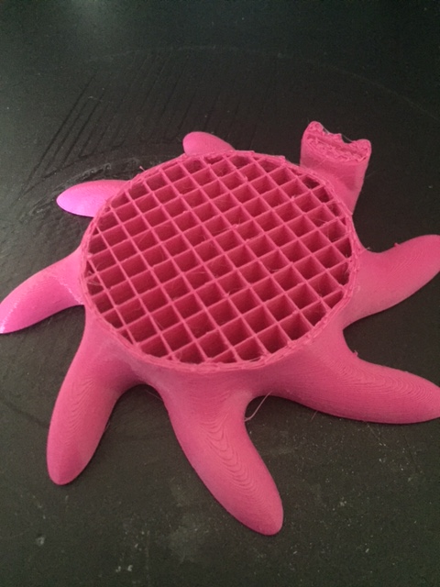
What is Infill?
Infill is the density that you want your model to print at. A more dense infill will use more material and take longer to 3D print.

Slide 17
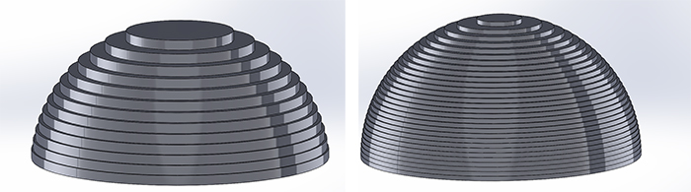
What is layer height?
Layer height is the thickness of each layer that the 3D printer prints.
The smaller the layer height the more detailed the end result will be.
The thicker the layer height will make the part less detailed.
The thicker the layer height the faster the model will 3D print.
https://support.3dverkstan.se/article/30-getting-better-prints

Slide 18
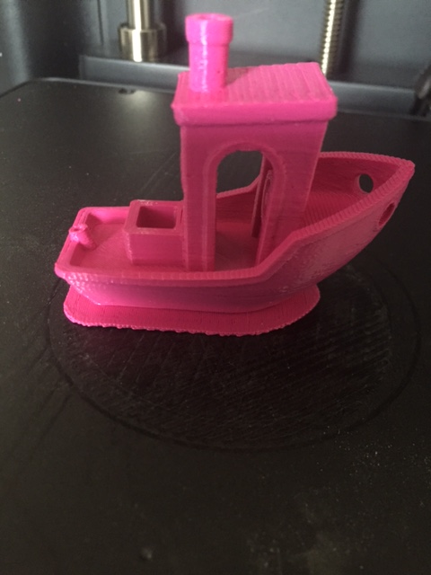
What is a Raft?
A raft is like a foundation for the 3D print. It helps stop the print from warping and is used to ensure that the print sticks to be bed.
Parts that may struggle to stick to the bed will need a raft to help them print.

